Slide 1

如何在Azure上进行Deep Learning
刘士君
微软创新技术合作事业部 技术顾问
shliup@microsoft.com

Slide 2
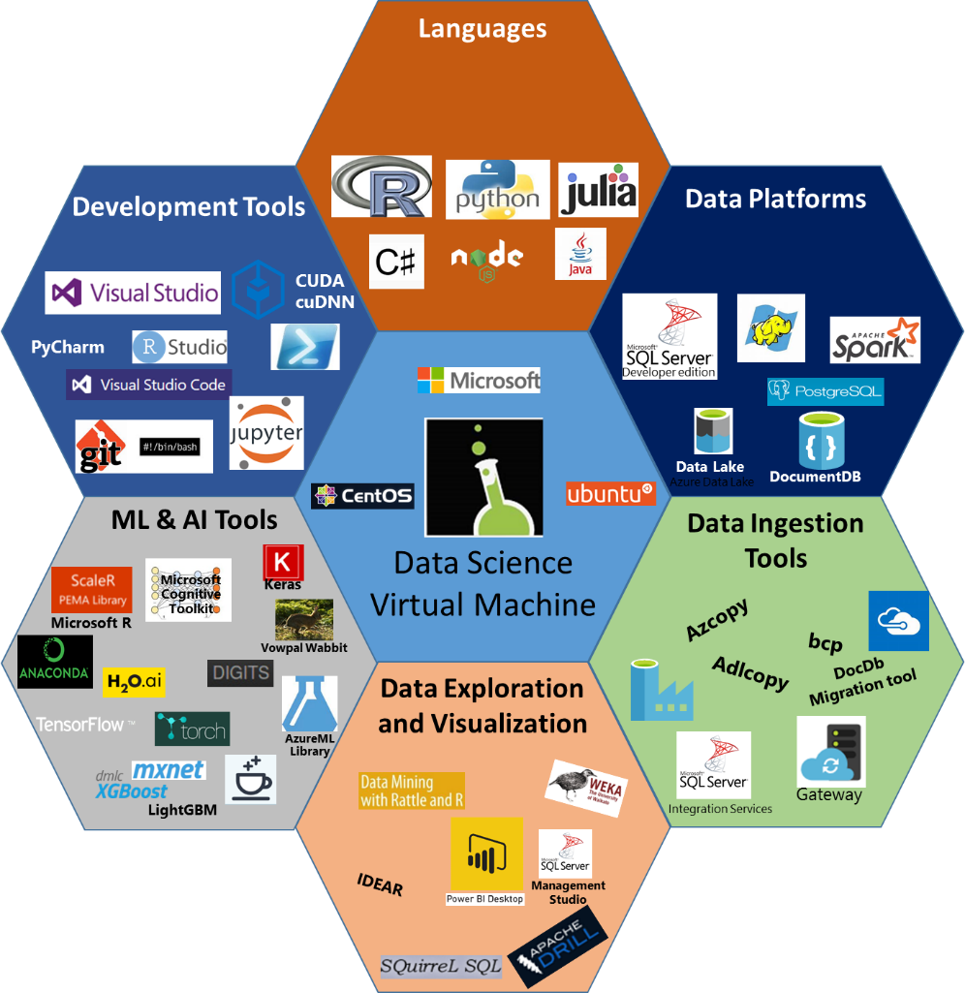
Data Science VM ?
Comprehensive cloud based Data Science Environment to empower Data Scientists

Slide 3
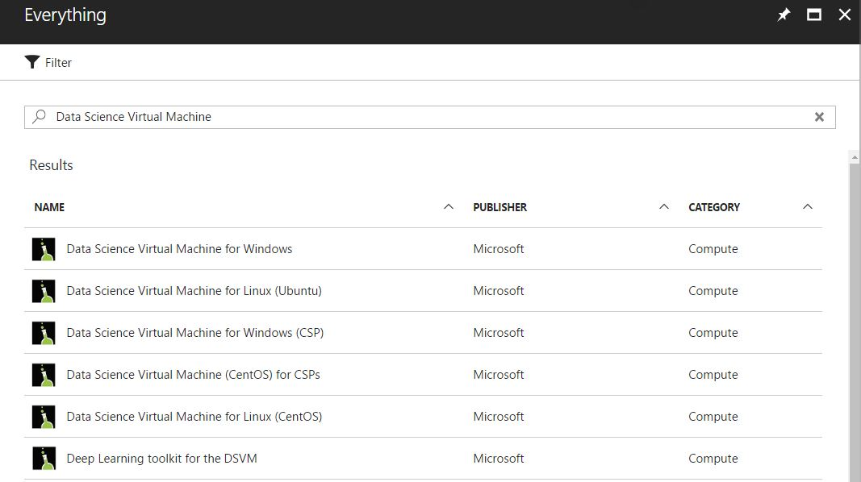
Azure Data Science VM
Support Multi-OS
CentOS\Ubuntu
Windows Server 2012/2016

Slide 4
Azure Data Science VM
预装和配置了多种常用的机器学习开发环境和工具:
CNTK, TensorFlow, MXNet, Caffe, DIGITS, H2O, Keras, Theano, Torch, OpenCV
NVIDIA driver, CUDA, and cuDNN
Microsoft R Server 9.0 with Microsoft R Open 3.3.2
Anaconda Python 2.7 and 3.5
JupyterHub with sample notebooks
Apache Drill for querying non-relational data using SQL
Spark local 2.0.2 with PySpark and SparkR Jupyter kernels
Single node local Hadoop (HDFS, Yarn)
Azure command-line interface
Visual Studio Code, IntelliJ IDEA, PyCharm, Atom
JuliaPro, a curated distribution of Julia Language and tools
Vowpal Wabbit for online learning
xgboost for gradient boosting

Slide 5
Azure Data Science VM for CV
Deep Learning Framework
Microsoft Cognitive ToolKit / TensorFlow / Caffe / MxNet / Keras / Torch / Theano
OpenCV 3.0
Anaconda Python 3.5
Jupyter Notebook
CUDA 8.0, CUDNN 5.1, Nvidia Driver
Support GPU/CPU
Notes:
好了，说了这么多，那我们来看看数据科学虚拟机。该虚拟机充分利用Azure云平台的特性，支持多种操作系统，同时预装了多种不同的深度学习框架，包括微软认知工具包，TensorFlow，Caffe，mxnet以及keras等。并且预置Python和R环境供用户使用，可以充分利用Azure云平台上的GPU资源。

Slide 6
Azure GPU VM
N-series VM
NC VM: Telsa K80
Size | vCPU | Memory: GiB | Temp storage (SSD) GiB | GPU | Maximum data disks
NC6 | 6 | 56 | 380 | 1 | 24
NC12 | 12 | 112 | 680 | 2 | 48
NC24 | 24 | 224 | 1440 | 4 | 64
NC24r* | 24 | 224 | 1440 | 4 | 64
1 GPU = one-half K80 card.
*RDMA capable
Notes:
NC: energy exploration applications, crash simulations, ray traced rendering, deep learning
NCv2: These GPUs can provide more than 2x the computational performance of the current NC-series. Customers can take advantage of these updated GPUs for traditional HPC workloads such as reservoir modeling, DNA sequencing, protein analysis, Monte Carlo simulations, and others.

Slide 7
Azure GPU VM
N-series VM
NCv2 VM: Telsa P100
2x the computational performance of the current NC-series:
Size | vCPU | Memory: GiB | Temp storage (SSD): GiB | GPU | Maximum data disks
NC6_v2 | 6 | 112 | 336 | 1 | 12
NC12_v2 | 12 | 224 | 672 | 2 | 24
NC24_v2 | 24 | 448 | 1344 | 4 | 32
NC24r_v2 | 24 | 1448 | 1344 | 4 | 32
For this size family, the vCPU (core) quota in your subscription is initially set to 0 in each region.
1 GPU = one P100 card.
*RDMA capable
Notes:
Customers can take advantage of these updated GPUs for traditional HPC workloads such as reservoir modeling, DNA sequencing, protein analysis, Monte Carlo simulations, and others.

Slide 8
Azure GPU VM
N-series VM
ND VM: Telsa P40
Excellent performance for single-precision floating point operations, also offers a much larger GPU memory size (24 GB)
Size | vCPU | Memory: GiB | Temp storage (SSD) GiB | GPU | Maximum data disks
Standard_ND6 | 6 | 112 | 336 | 1 | 12
Standard_ND12 | 12 | 224 | 672 | 2 | 24
Standard_ND24 | 24 | 448 | 1344 | 4 | 32
Standard_ND24r* | 24 | 1448 | 1344 | 4 | 32
Notes:
ND: These instances provide excellent performance for single-precision floating point operations, for AI workloads utilizing Microsoft Cognitive Toolkit. The ND-series also offers a much larger GPU memory size (24 GB), enabling to fit much larger neural net models.

Slide 9
Azure GPU VM
N-series VM
NV VM: Telsa M60
NVIDIA GRID technology for desktop accelerated applications and virtual desktops where customers are able to visualize their data or simulations.
Size | vCPU | Memory: GiB | Temp storage (SSD) GiB | GPU | Maximum data disks
NV6 | 6 | 56 | 380 | 1 | 24
NV12 | 12 | 112 | 680 | 2 | 48
NV24 | 24 | 224 | 1440 | 4 | 64
1 GPU = one-half M60 card.
可用区域查看： https://azure.microsoft.com/zh-cn/regions/services/

Slide 10
Azure Data Science VM Key Scenarios
Preconfigured analytics desktop in the cloud
Data science training and education
On-demand elastic capacity for large-scale projects
Short-term experimentation and evaluation
Deep learning GPU Acceleration
Notes:
同时其应用也更为广泛，利用Azure云平台的灵活性和可伸缩性以及GPU等硬件资源，可以在多种场合合理利用数据科学虚拟机。
比如，
在云中预配分析桌面，确保团队中的所有数据科学家具有可验证实验并促进协作的一致设置。 通过减少 sysadmin 负担并节省评估、安装和维护高级分析所需各种程序包所需的时间，它还降低了成本。
或者
进行数据科学训练和培训的时候确保学生设置一致，并可以预测示例运行情况。
而对于大型项目的按需弹性容量，比如数据科学编程马拉松/竞赛或大型数据建模和浏览需要扩展的硬件容量，通常持续时间比较短。 数据科学 VM 可有助于在支持需要运行高性能计算资源的扩展服务器上按照需要快速复制数据科学环境。
同样的对于短期实验和评估，数据科学 VM 可用于评估或学习工具。
最最重要的就是进行深度学习GPU加速，用于在基于 GPU（图形处理单元）的硬件上使用深度学习算法的训练模型。

Slide 11
演示：如何创建DSVM

Slide 12
演示：DSVM + Keras + CNTK + Sentiment Analytics
Notes:
https://github.com/THULiusj/SentimentAnalytics-Keras-CNTK-LSTM

Slide 13
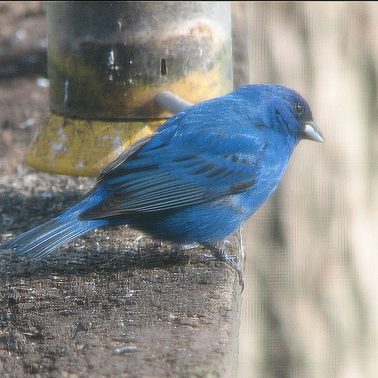
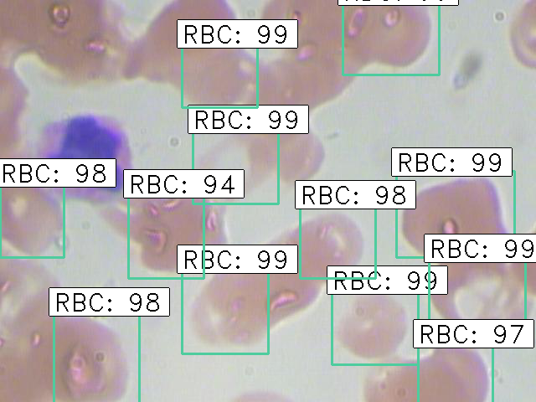
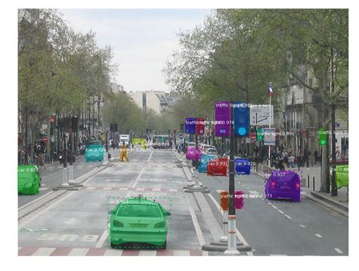
Computer Vision
Image Classification
Object Detection
Image Segmentation
……
label
x1,y1,x2,y2,label

Slide 14
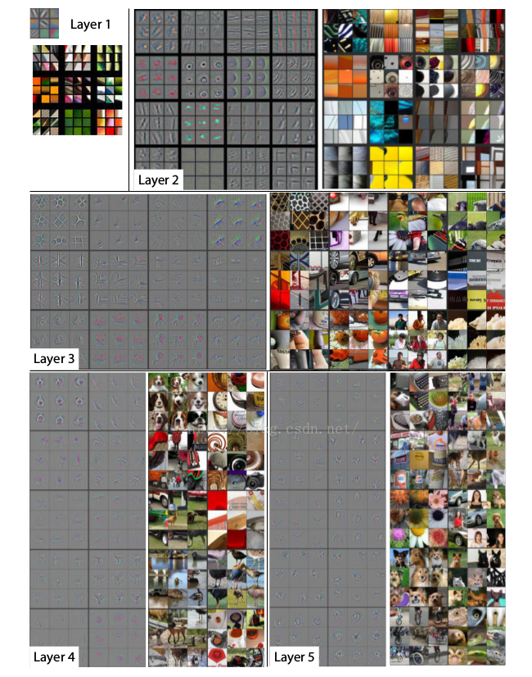
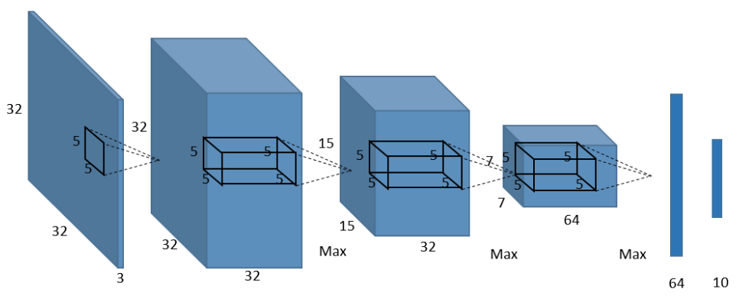
Image Classification
CNN + Transfer Learning
CNN

Slide 15
Image Classification
CNN + Transfer Learning: for small dataset
Transfer Learning
VGG_16 + TL
Resnet_50 + TL
Inception_V3 + TL
Pre-trained & Freeze
Train with custom dataset

Slide 16
演示：DSVM + Keras + Tensorflow + Bird Classification
Notes:
https://github.com/THULiusj/BirdClassification-Keras-Tensorflow-Inception

Slide 17
Object Detection
YOLOv2 —— object detection – fast - video
Faster RCNN —— object detection – accuracy - image
SSD —— object detection
Mask RCNN —— classification, detection & segmentation
RetinaNet —— Dense object detection

Slide 18
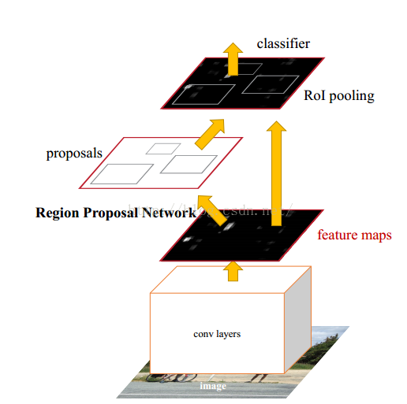
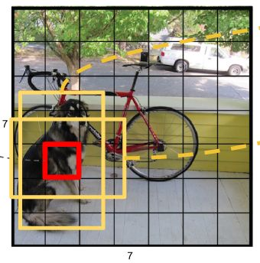
Object Detection
YOLOv2
Faster RCNN
1. CNN+TL: feature extraction
2. Windows detection
Fast; Not applied to small and close objects
Slow; More accurate
Notes:
RPN?这个怎么训练的？

Slide 19
演示：DSVM + Keras + Tensorflow + Cosmicad Detection
Notes:
https://github.com/THULiusj/CosmicadDetection-Keras-Tensorflow-FasterRCNN

